Slide 1
(Very short) Introduction to HL7 FHIR
June, 2012
Grahame Grieve, Health Intersections
Ewout Kramer, Furore
Lloyd McKenzie, Gordon Point Informatics

Slide 2
ast
(to design & implement)
ealthcare
nteroperability
esources

Slide 3
What is FHIR?
Fast Healthcare Interoperability Resources
Pronounced “FIRE”
As significant as change from v2 to v3
Won’t be marketed as “v4” though
New artifacts
New methodology
New tools
New publishing approach
Still built on RIM, vocab & datatypes, but more hidden

Slide 4
Outline
FHIR So Far
Why FHIR?
What is FHIR?
Next Steps
Q&A

Slide 5
Fhir SO FAR

Slide 6
Fresh Look
January 2011, the HL7 Board initiated a project called “Fresh Look”
“what would we do if we were to revisit the healthcare interoperability space from scratch?”
Sept. 2011, Grahame Grieve discussed some of the challenges (and successes) of HL7 v3 on his blog
Sept. 2011 WGM, First “preview” draft of FHIR, met with a very positive response

Slide 7
Transition to HL7
March 2012, HL7 Board of Directors agreed to a transfer of FHIR IP to HL7
Condition is that first normative edition of FHIR be made available for free to all implementers
Content now hosted on HL7 SVN under its own g-Forge project
Publication under HL7 URL:
http://www.hl7.org/fhir

Slide 8
Who are we?
Grahame Grieve, Lloyd McKenzie, Ewout Kramer
Jean-Henri Duteau, Andy Stechishin, Woody Beeler, Gerald Beuchelt
Austin Kreisler, Bo Dagnall, Ron Parker, Klaus Veil, Rene Spronk, Lynn Laakso

Slide 9
Why FHIR?

Slide 10
V3 is too hard - result
Development process is slow
3-7+ years for a domain to become normative
Poor market penetration
Very little up-take without major sponsorship (and investment) by large projects
V3 messaging is non-starter in the US, despite massive activity & investment in healthcare interoperability

Slide 11
V3 is too hard?
V3 puts needs of the modeler before the needs of the implementer
Learning curve is too steep
Must significantly constrain to allow implementation
Tools to develop, maintain & constrain are all custom
Wire format is unstable

Slide 12
New Markets
If someone is building a new iOS healthcare app (and thousands are), what standard do we point them at?
If someone wants to provide a cloud based health app that integrates with social networks, what standard should they use?
If a vendor wants to provide a simple to use standards based API to cloud based health integration services, what standard should they extend?
If a government wants to implement a national EHR, who should they talk to?

Slide 13
What is FHIR?

Slide 14
Caveats !
FHIR is a work in progress
Specification has been looked at by many people, but not subjected to ballot or any official review
FHIR continues to evolve
Much of what we tell you could change, at least somewhat, before it is stable

Slide 15
FHIR premises
Design for the 80%, not 100%
Only include data elements in the artifacts if 80% of all implementers of that artifact will use the data element
Allow easy extension for the remaining 20% of elements
which often make up 80% of current specs
Vocabulary approach to extension definition
Focus publication on documenting what the implementer needs, not what the modelers thought or designers need to remember

Slide 16
FHIR Basics
Build around the concept of “resources”
Small, discrete concepts that can be maintained independently
Similar to the concept of CMETs, but there’s only *one* model per resource
Aligns with RESTful design philosophy
Each resource has a unique URL
Resources are smallest units of transaction
HTTP based atomic transactions for CRUD Operations

Slide 17
FHIR Basics (cont’d)
Built-in extension mechanism
Extension is not a “dirty word” in FHIR
Wire format remains stable, even as extensions occur
Full support for textual mark-up
With FHIR, all resources, as well as all resource attributes have a free-text expression, an encoded expression or both
Mark up is xhtml directly

Slide 18
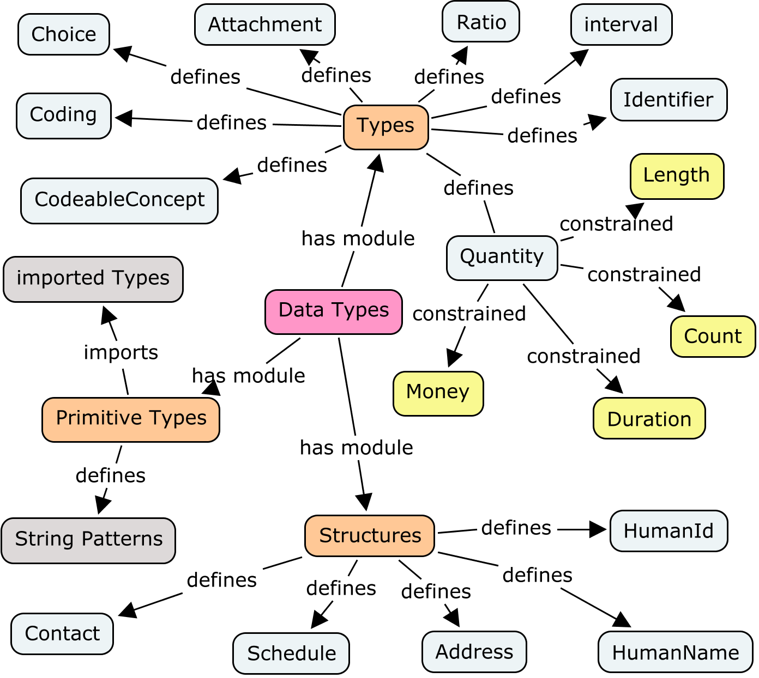
New datatypes model

Slide 19
Resource
Primary artifact
Like CMETs, but only one for each concept
no ‘flavors’ like contactable, universal
All defined by HL7
100-150 total for all of healthcare. Ever
Can be maintained separately
Examples:
Person, Patient, Prescription, etc.

Slide 20
Resource representations
Each resource is published with several views covering different aspects
UML diagram
Simple pseudo-XML syntax
Vocabulary bindings
Notes
Search Criteria
Data dictionary
Example instance
Schema

Slide 21
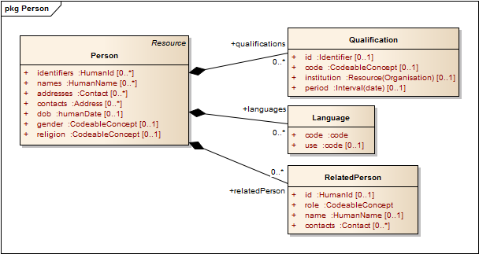
Example - Person

Slide 22
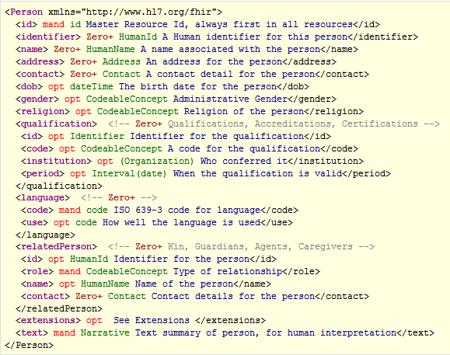
Example - Person

Slide 23
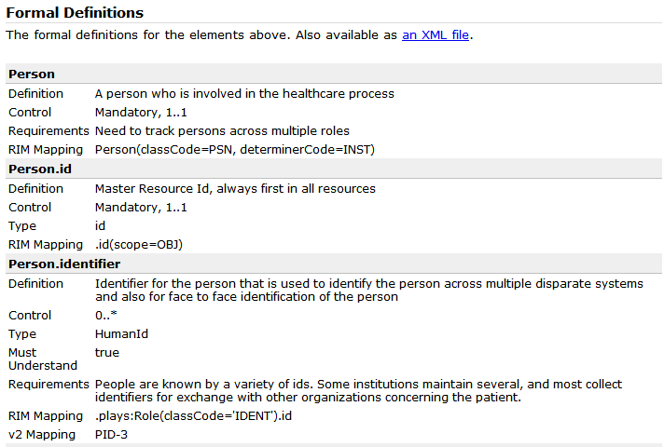
Example - Person

Slide 24
Messages
Collection of resources sent as a result of some real-world event intended to accomplish a particular purpose
Event Codes & Definitions, like HL7 v2
Some message profiles will be defined by HL7, others by projects or implementers
Includes a “Message” resource, similar in purpose to Message wrapper and MSH segment
May have associated behavior
Can be conveyed via MLLP, SOAP or other means

Slide 25
Documents
Collection of resources grouped for persistence and attestation
Some document profiles will be defined by HL7, others by projects or implementers
Includes a “Document” resource, similar in purpose to CDA header

Slide 26
Profiles
The FHIR specification describes a set of base resources. These resources are used in many different contexts in healthcare. In order to make this manageable, applications and specifications need to be able to:
Explain how a set of resources is used in a particular context
Describe restrictions on the use of the elements defined as part of the resource(s)
Define the extensions that are used with the resources
Describe how resources are bound to terminology in a particular context

Slide 27
Tools
Generation tool built in Java. Anyone can build the publication at will
Source files maintained as xml spreadsheets
Easy Editing
Easy source control & Easy merging
Easy importing into whatever
May get more sophisticated tooling over time (e.g. vocab support)
Will likely need tooling to help with mapping and particularly with defining conformance profiles
Need registry tool to manage registered extensions too

Slide 28
Publishing
Current version at http://www.hl7.org/fhir
Implies a new & different ballot publication process
FHIR is balloted as a single spec like v2
Instance example mandatory
Publication automatically generated from source files – by anyone
Schemas
HTML
Validation of instance example
reference implementations: Java, C#, others

Slide 29
What next?

Slide 30
Working with Workgroups
Who owns what resource?
When do we create a new resource?
Need to avoid overlap
Existing problem becomes more important
What fits in the 80%?
How much time to we give to FHIR vs. traditional v3?
When faced with a use-case, do we use documents, messages, services or REST?
Can do all of the above, but multiple solutions could have interoperability consequences

Slide 31
Follow-up
Review content on the FHIR site
http://www.hl7.org/fhir
Provide feedback on the wiki
Mailinglist:
fhir@lists.hl7.org

Slide 32
Contacts
FHIR Mailing list: fhir@lists.hl7.org
Grahame: grahame@healthintersections.com.au
Ewout: e.kramer@furore.com
Lloyd: lloyd@lmckenzie.com

Slide 33
Questions & Answers

Slide 34
Q&A
What’s the timeline?
Initial methodology ballot this summer
DSTU first ballot of initial set of resources this fall
In theory could be done DSTU of implementable chunk of FHIR in 2 years
In practice, dependent on work of committees

